Slide 1
Airbnb Toronto Data Analysis
An attempt to find if and how weather and crime are related

Slide 2
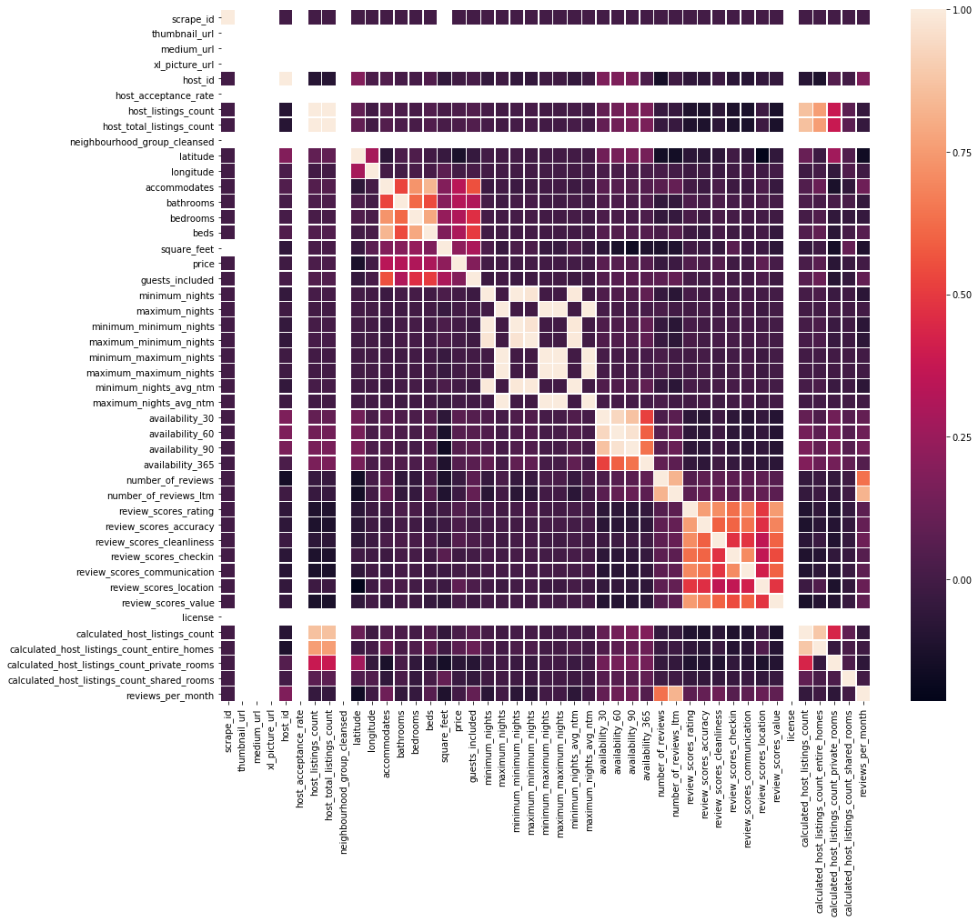
Airbnb Toronto Data Analysis Correlation Matrix – All Attributes

Slide 3
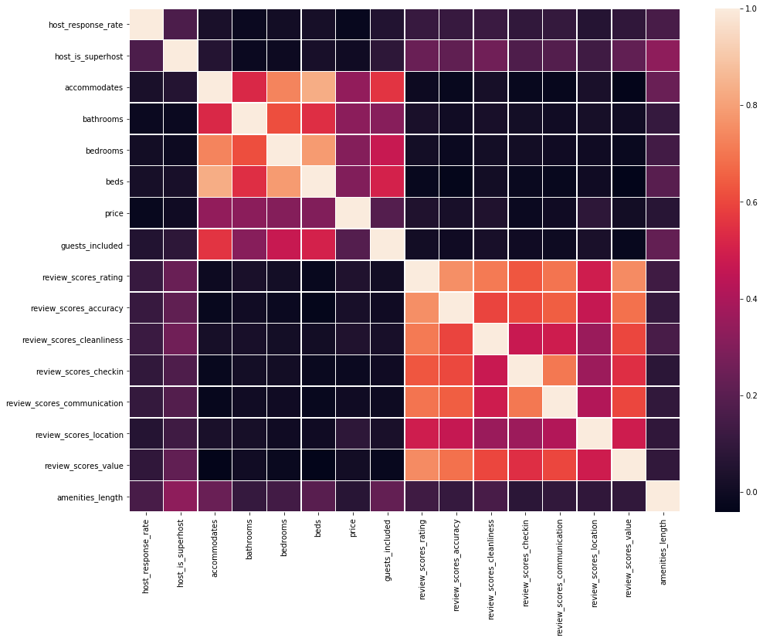
Airbnb Toronto Data Analysis Correlation Matrix – Selected Attributes

Slide 4
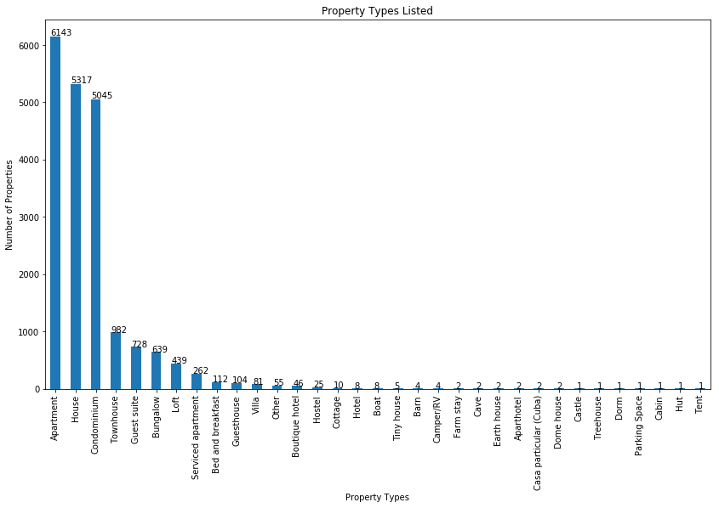
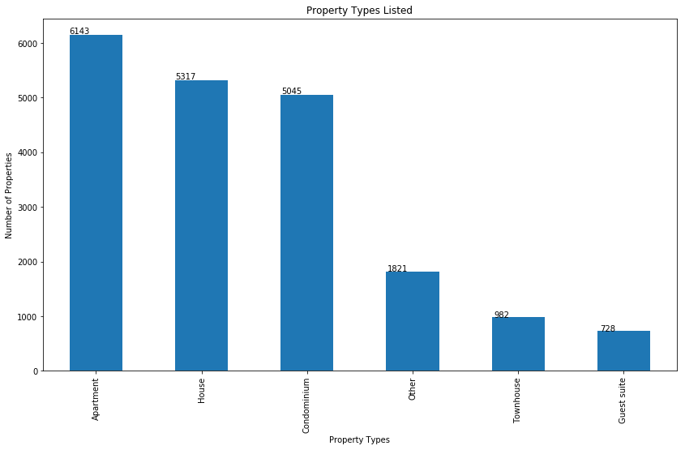
Airbnb Toronto Data Analysis Property types listed

Slide 5
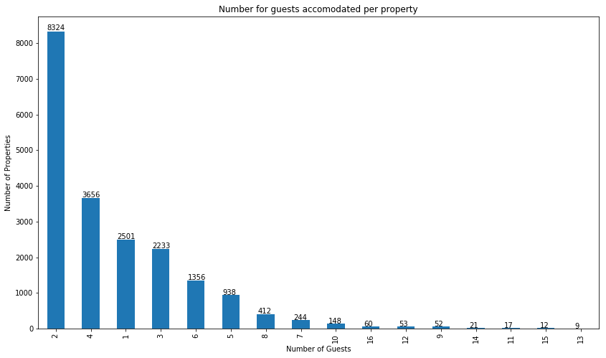
Airbnb Toronto Data Analysis Guests allowed per property

Slide 6
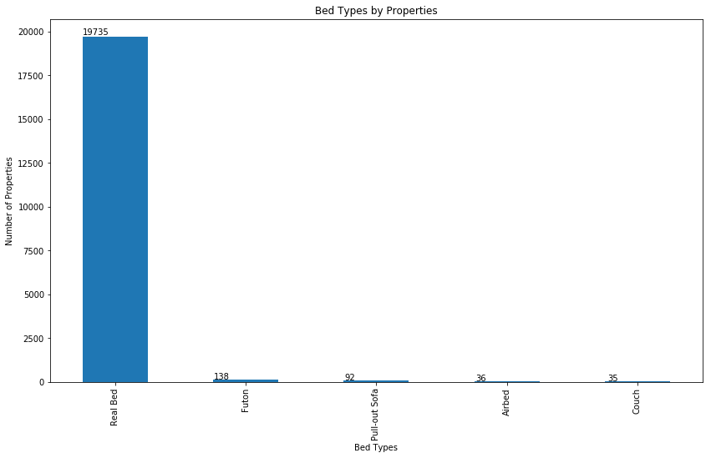
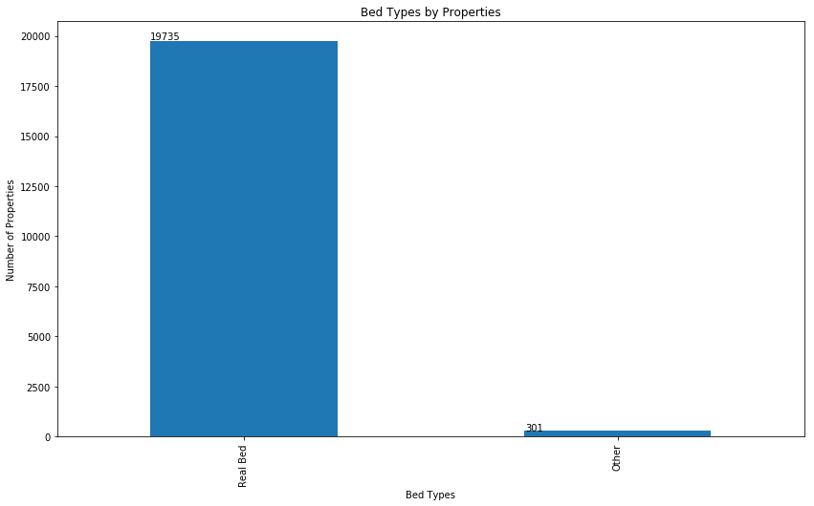
Airbnb Toronto Data Analysis Bed types listed

Slide 7
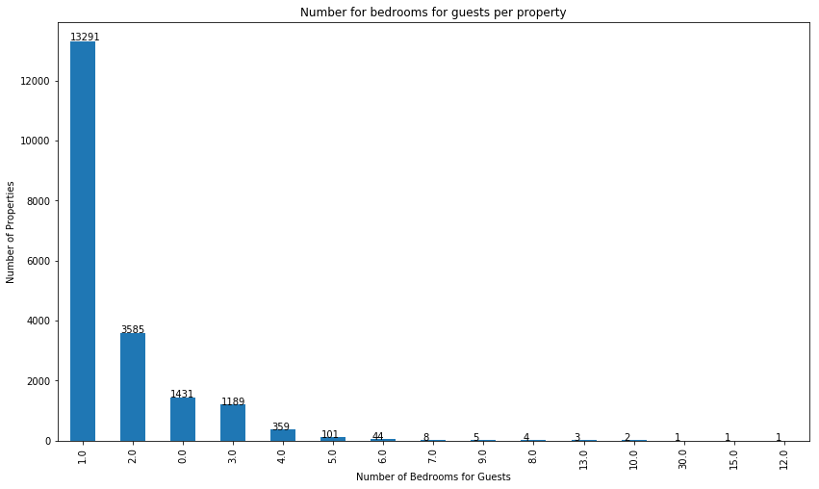
Airbnb Toronto Data Analysis Number of bedrooms

Slide 8
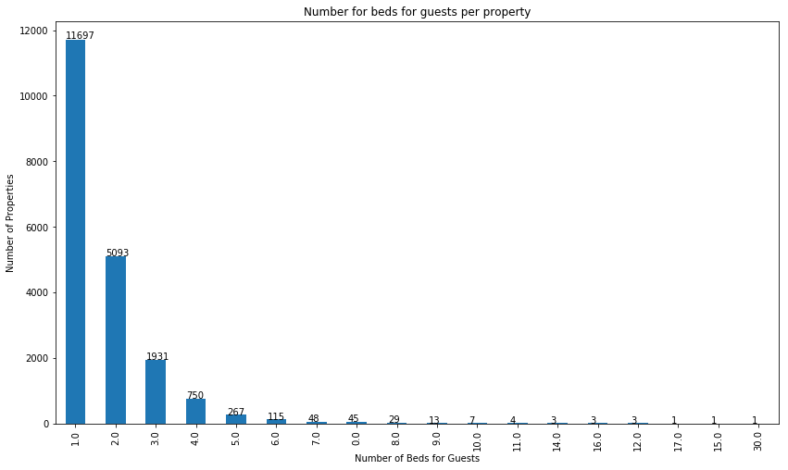
Airbnb Toronto Data Analysis Number of beds for guests per property

Slide 9
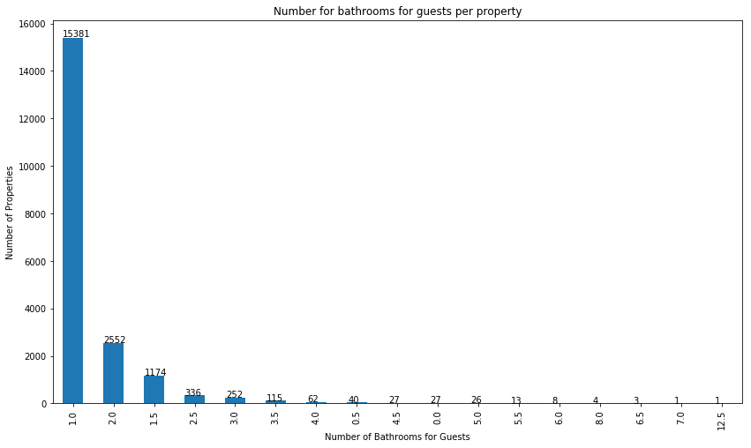
Airbnb Toronto Data Analysis Number of bathrooms for guests per property

Slide 10
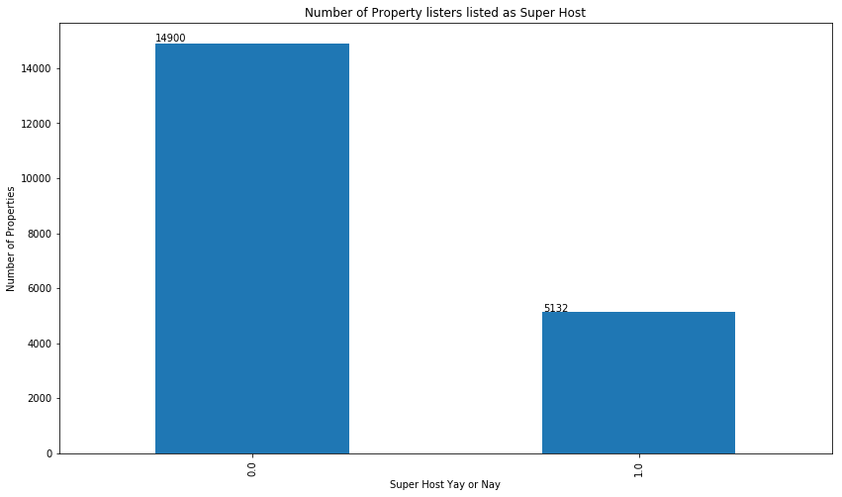
Airbnb Toronto Data Analysis Number of hosts listed as super hosts

Slide 11
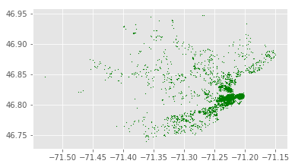
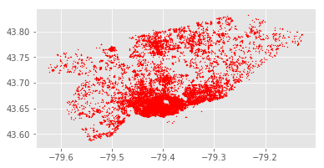
Airbnb Toronto Data Analysis Number of hosts listed as super hosts
Toronto
Quebec

Slide 12
Airbnb Toronto Data Analysis Few of the Next Possible Steps
Sentiment Analysis using Natural Language Took Kit (NLTK) and TextBlob
Price Prediction
Finding out what makes a property successful, e.g. which amenities are most important, and what other factors decide success
Help in deciding in which locations to invest for starting an Airbnb business

Slide 13
Thank You

